Slide 1
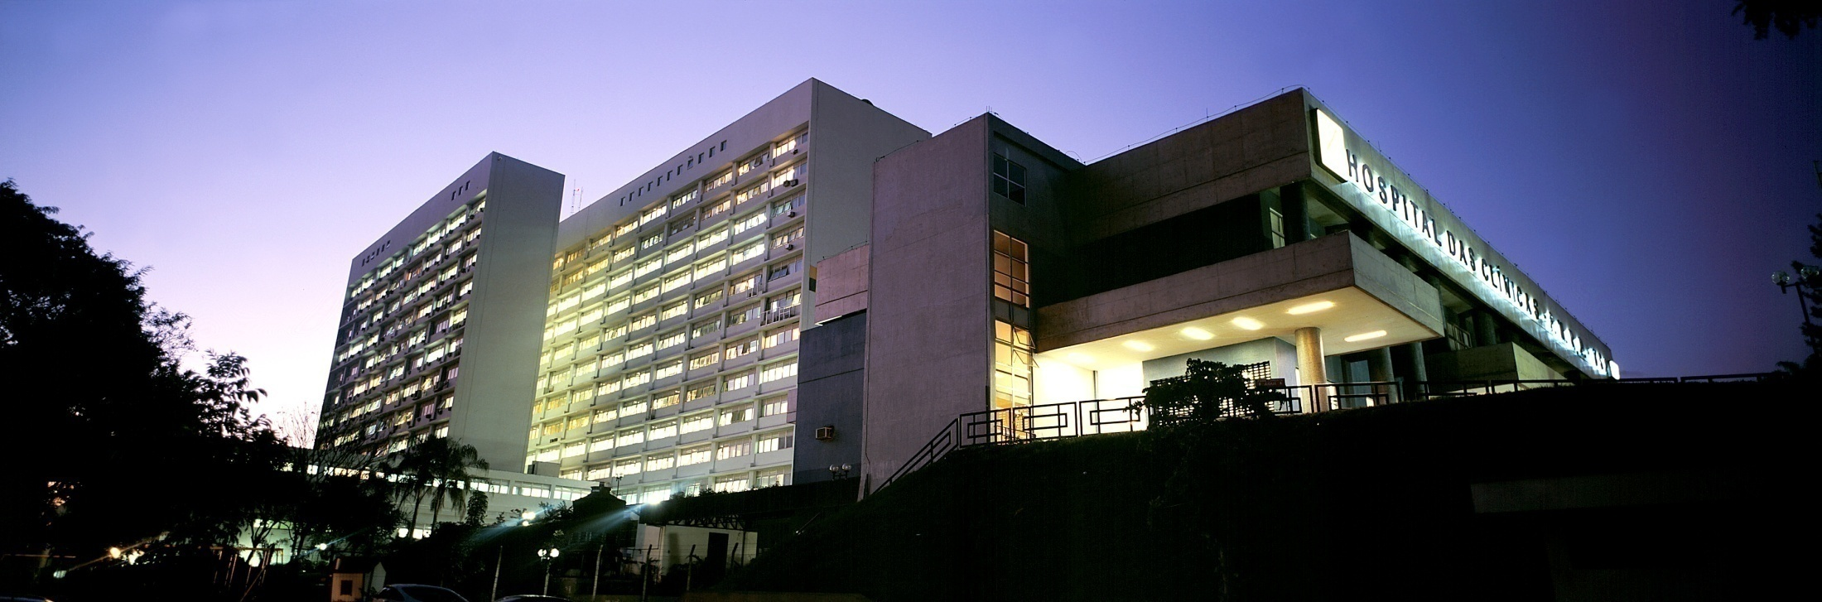

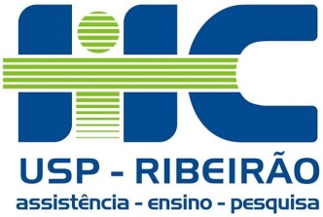
Perspectives in
Interventional Radiology
Humboldt Kolleg - Limits and Interfaces in Science
Guilherme S. Nakiri
Division of Interventional Radiology
CCIFM – HC – FMRP - USP

Slide 2
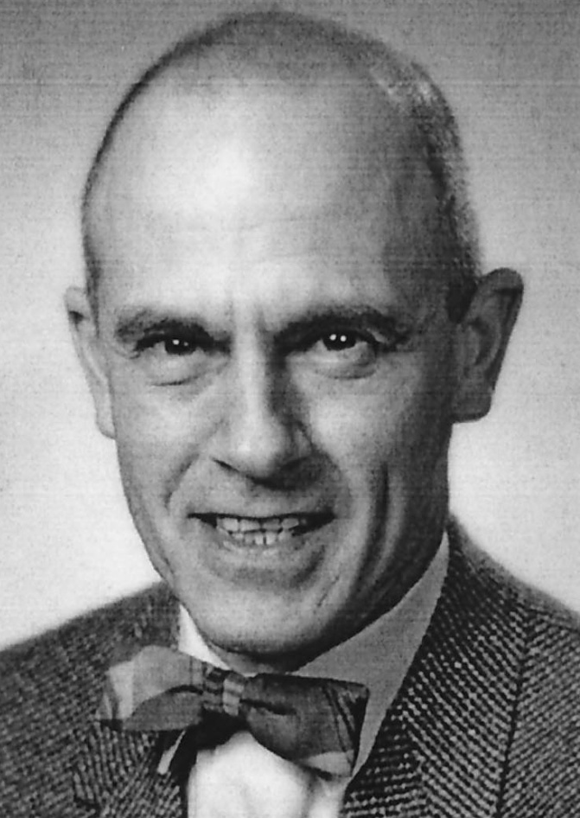
BIRTH OF A NEW SPECIALTY
●Charles Dotter MD
● 1963
● Czechoslovak
Radiological
Congress
● Therapeutic use of
endovascular catheter
Notes:
On June 19, 1963, at the Czechoslovak Radiological Congress in Karlovy Vary.
By many accounts, the field of interventional radiology was born in a 1963 speech at the Czechoslovak Radiological
Congress , when Charles Dotter, a radiologist trained at Cornell University and, at the time, practicing and teaching at the
University of Oregon, first officially spoke about the therapeutic possibilities of the use of an endovascular catheter, until then a device used only for diagnostic purposes. Before proceeding with the explanation of C. Dotter’s achievements in the interventional radiology field, we must mention who gave the proper conditions for these advances.

Slide 3
BIRTH OF A NEW SPECIALTY
●Sven-Ivar Seldinger MD
● 1953
● Description of the
Seldinger technique
● Safe access to blood
vessels and other hollow
organs
Notes:
10 years before Charles Dotter’s speech that Dr. Seldinger a Swedish radiologist, described the technique named after him, to obtain safe access to blood vessels and other hollow organs.

Slide 4
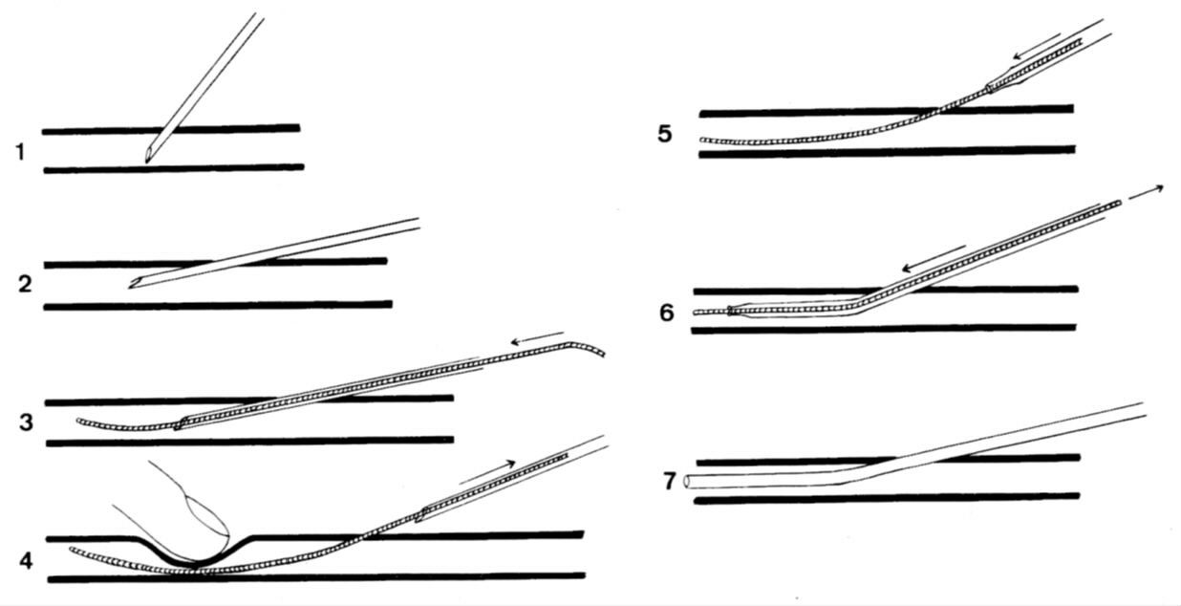
SELDINGER TECHNIQUE
Notes:
The desired vessel or cavity is punctured with a sharp hollow needle called a trocar. A round-tipped guidewire is then advanced through the lumen of the trocar, and the trocar is withdrawn. A "sheath" or blunt cannula can now be passed over the guidewire into the cavity or vessel.

Slide 5
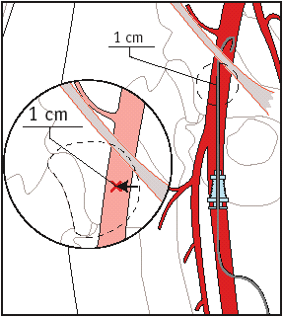
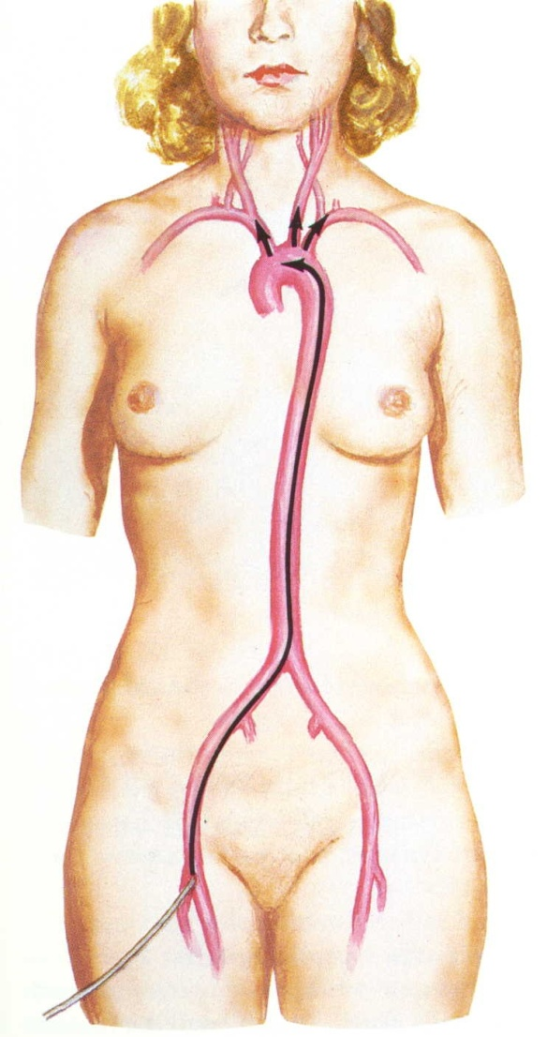
SELDINGER TECHNIQUE
Notes:
Prior to the description of the Seldinger technique, sharp trocars were used to create lumens through which devices could be passed. This had a high rate of complications. However, with the introduction of the Seldinger technique, angiography became a relatively risk-free procedure, and the field of interventional radiology blossomed.

Slide 6
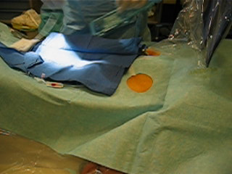
FEMORAL ARTERY ACCESS
Notes:
Femoral artery puncture, with introduction of an hemostatic sheath, which allow us to gain access to the vessel without blood loss trough the puncture site

Slide 7
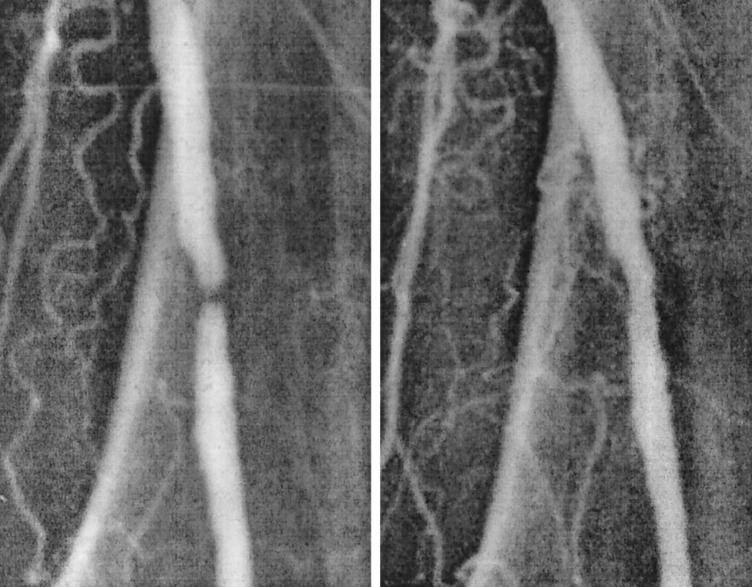
FIRST STEP OF INTERVENTIONAL RADIOLOGY
●Charles Dotter MD
● 1964
● 82-year-old woman
leg ischemia
and gangrene
● Sucessfull dilatation
of stenosis with guide wire
and coaxial catheters
Notes:
C. Dotter became definitely the father of Interventional radiology , when, in January 16, 1964, he percutaneously dilated a tight, localized stenosis of the superficial femoral artery in an 82-year-old woman with painful leg ischemia and gangrene who refused leg amputation. After successful dilation of the stenosis with a guide wire and coaxial Teflon catheters, the circulation returned to her leg. She left the hospital on her feet—both of them.The dilated artery stayed open until her death from pneumonia 2.5 years
later.

Slide 8
INTERVENTIONAL RADIOLOGY TODAY
Interventional Radiology
Therapeutic Neuroradiology
Periphereal Vascular Interventional Radiology
Non Vascular Interventional Radiology

Slide 9
THERAPEUTIC NEURORADIOLOGY
● Brain Aneurysms
● Arteriovenous Malformations
● Dural Arteriovenous Fistulas
● Cervical and Intracranial Atherosclerosis
● Preoperatory tumor embolization
● Spinal Cord Vascular Malformations
● Acute Stroke Treatment

Slide 10
PERIPHEREAL VASCULAR IR
● Periphereal Arteries Stenosis/Occlusion
● Aortic Aneurysm
● Curative, preoperatory and paliative tumor embolization
● Vascular Malformations
● Vascular Trauma
● Venous diseases (pelvic varices)

Slide 11
NON VASCULAR IR
● Biopsies
● Nephrostomies
● Non Vascular Stents (biliary tract, colonic, tracheal)
● Alcoholization
● Percutanous Gastrostomy

Slide 12
INTERVENTIONAL RADIOLOGY
●Principle: to provide minimally invasive treatment to pathologies that would otherwise require open surgery or wouldn’t be accessible by conventional approach.
●Using imaging guidance by:
- Computed Tomography CT
- Ultrasound US
- Digital Subtraction Angiography DSA
- Radioscopy

Slide 13
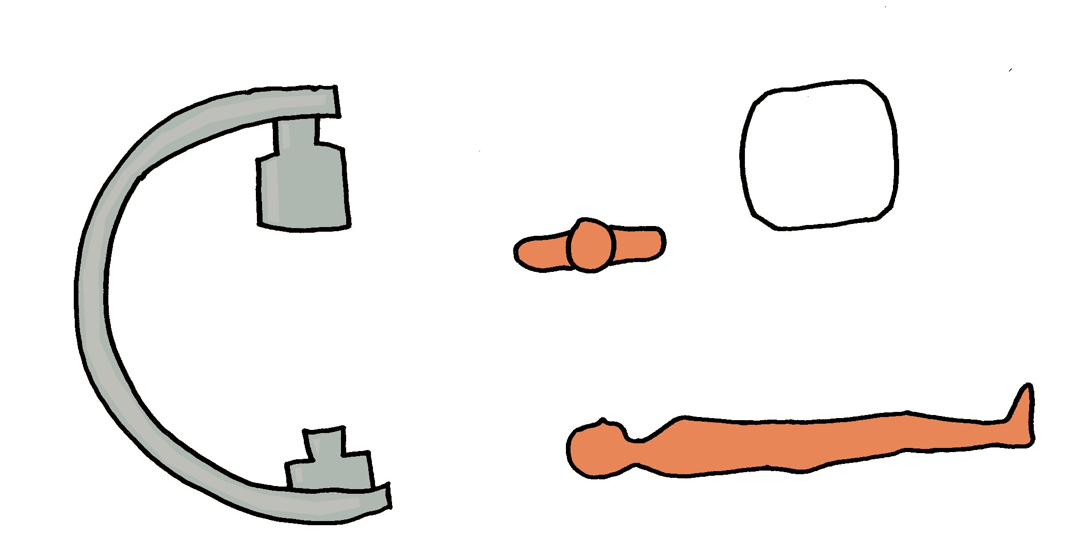
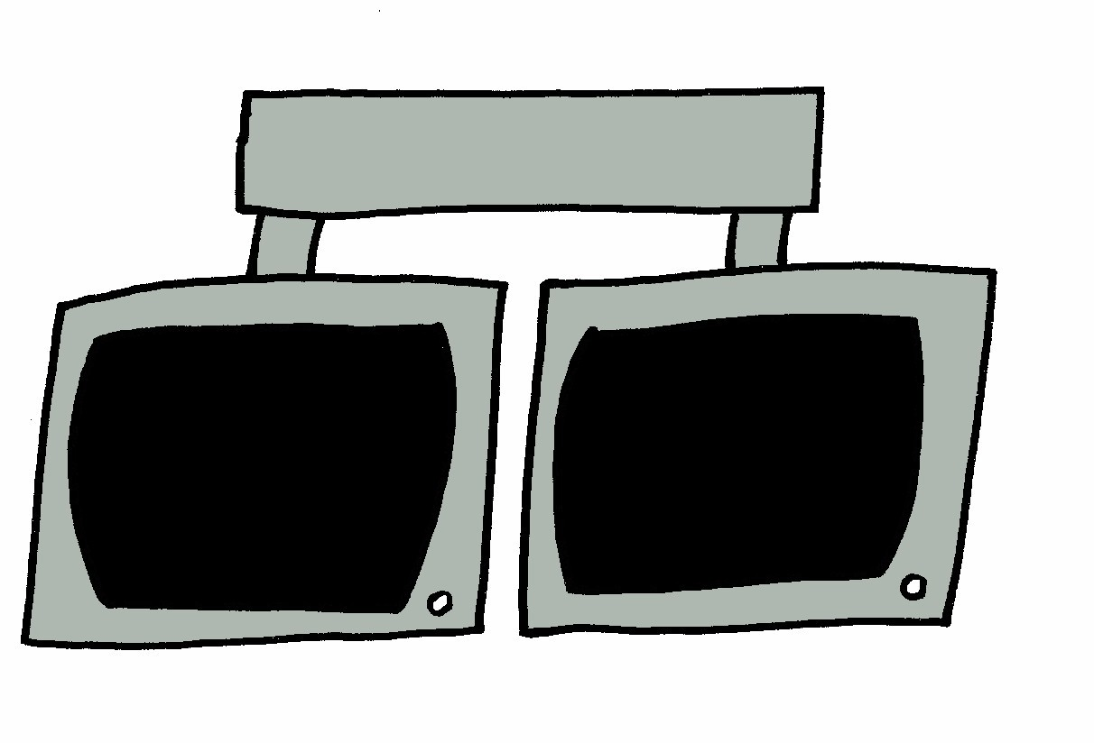
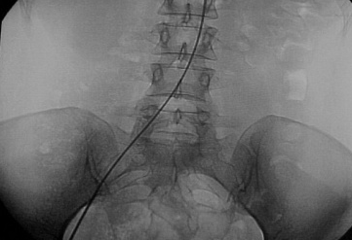

ARTERIOGRAPHY
Notes:
DSA Digital Substraction Angiography was introduced in the early 1980s. In this technique, na X-ray image is obtained before the contrast agent is injected. After injecting the contrast agent, the radiologist obtain another X-ray image that highlights blood flow. The 2 images are superimposed by the computer, which then substracts the 1st imagem from the 2nd, leaving only the changed portions.

Slide 14

X-Ray
0s
Notes:
DSA Digital Substraction Angiography was introduced in the early 1980s. In this technique, na X-ray image is obtained before the contrast agent is injected. After injecting the contrast agent, the radiologist obtain another X-ray image that highlights blood flow. The 2 images are superimposed by the computer, which then substracts the 1st imagem from the 2nd, leaving only the changed portions.

Slide 15
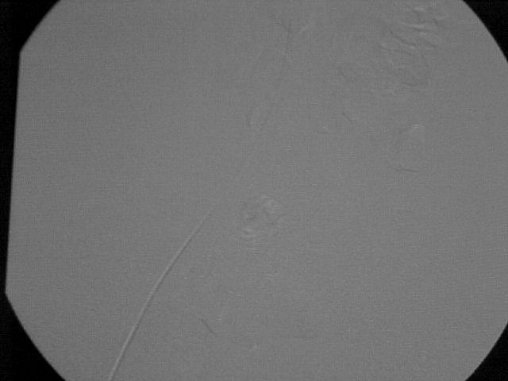
Mask
1s
Notes:
After injecting the contrast agent, the radiologist obtain another X-ray image that highlights blood flow. The 2 images are superimposed by the computer, which then substracts the 1st imagem from the 2nd, leaving only the changed portions.

Slide 16
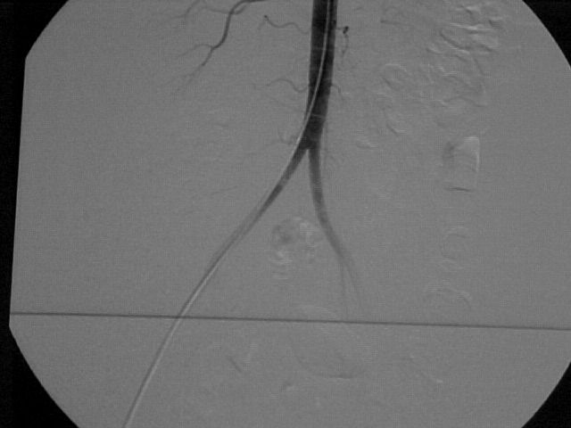
With Substraction
2s

Slide 17
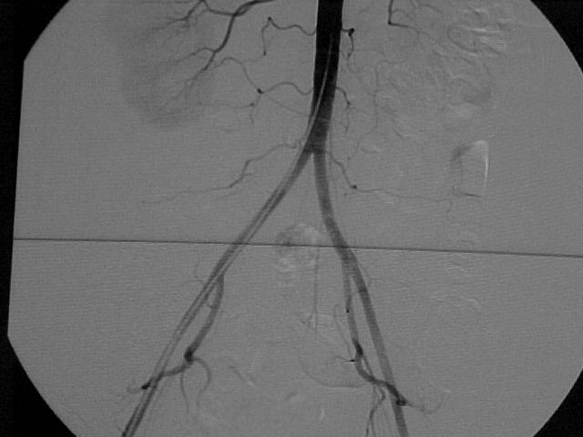
3s

Slide 18
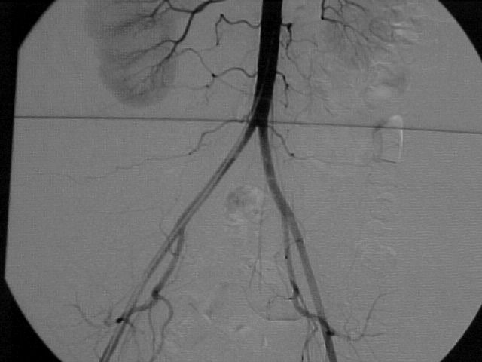
4s

Slide 19
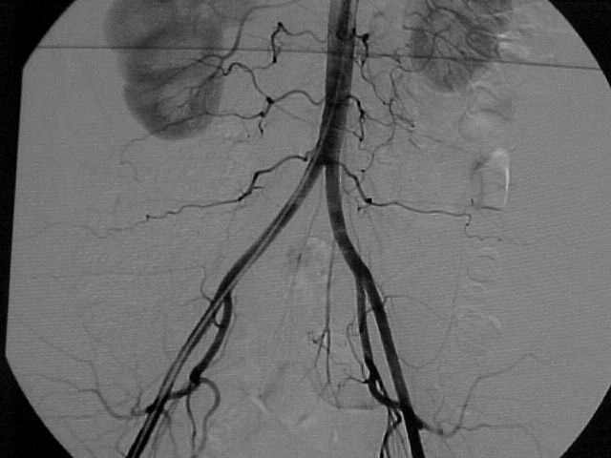
5s

Slide 20
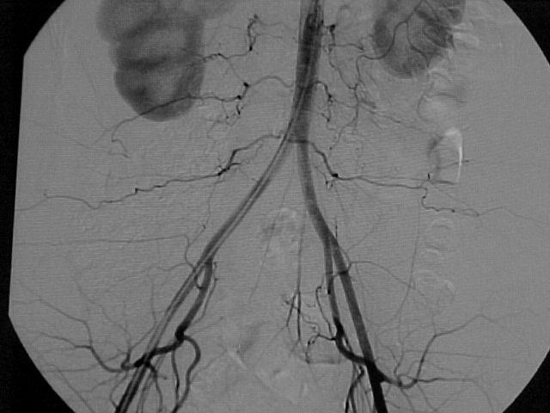
6s

Slide 21
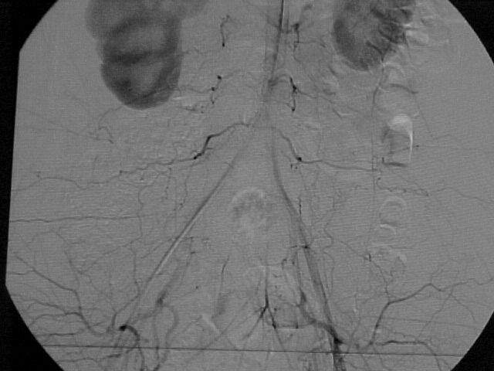
7s

Slide 22
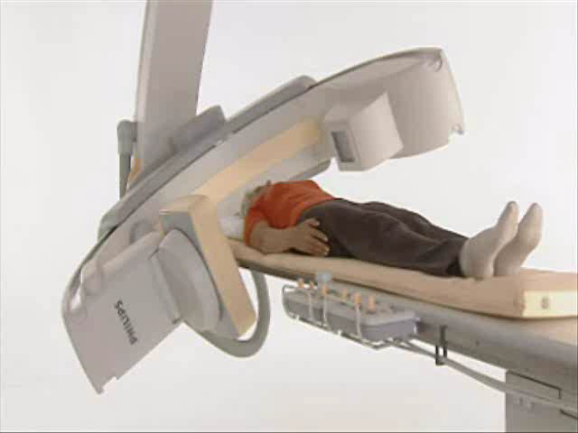
Rotational Angiography with
3D Reconstruction

Slide 23
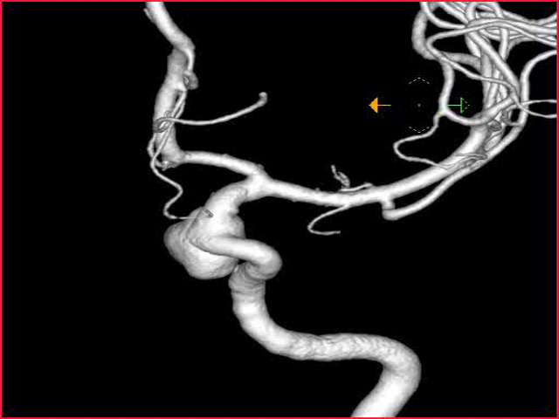
Rotational Angiography with
3D Reconstruction

Slide 24
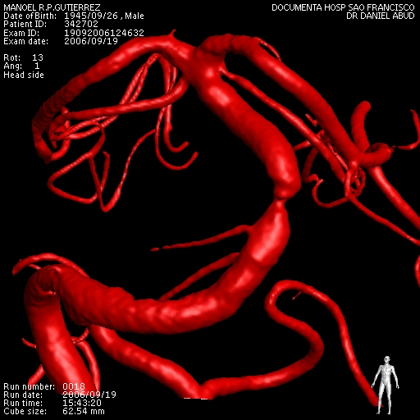
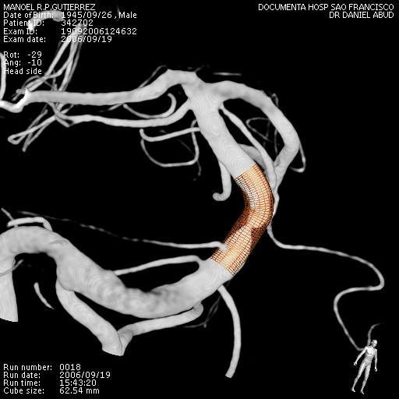
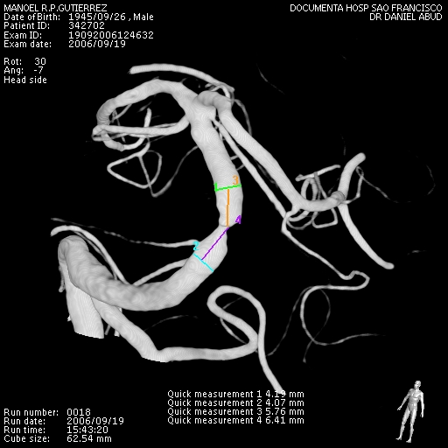
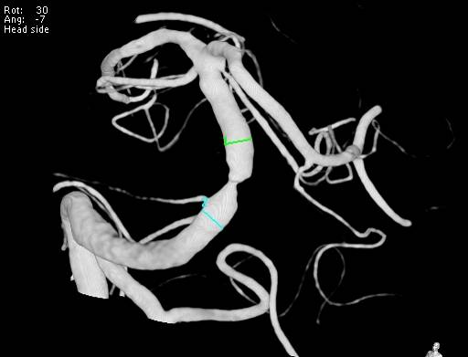

Slide 25
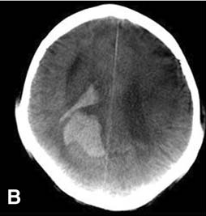
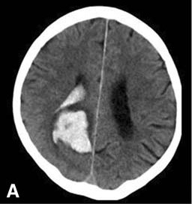
CT Like

Slide 26
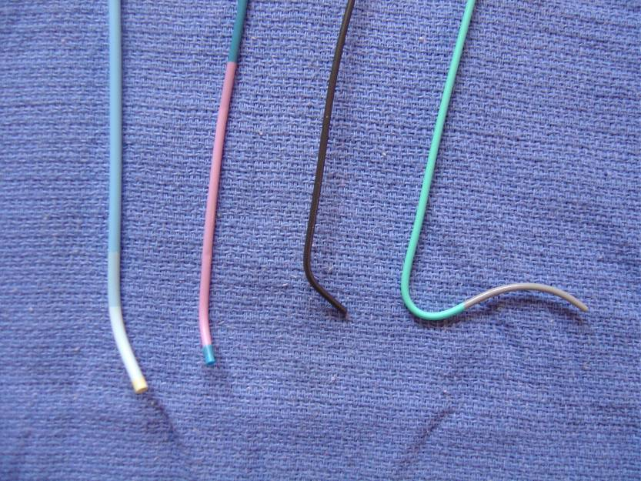
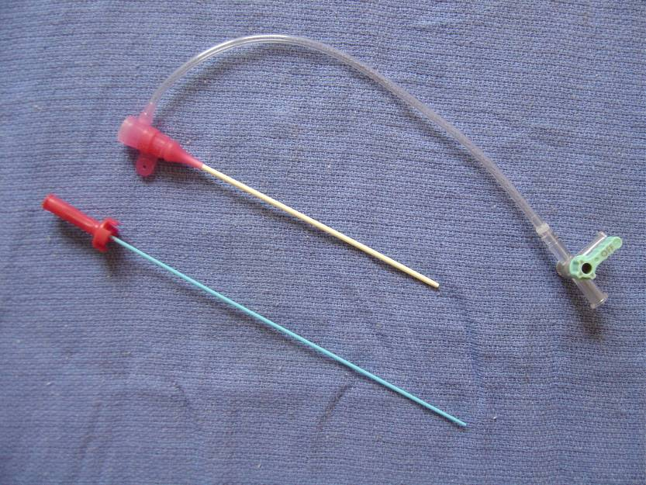
MATERIALS
Notes:
Catheters and hemostatic sheath, which allow us to gain access to the vessel without blood loss trough the puncture site

Slide 27
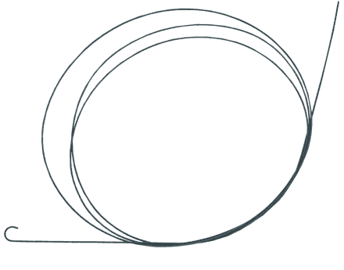
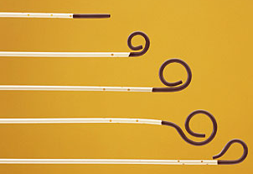
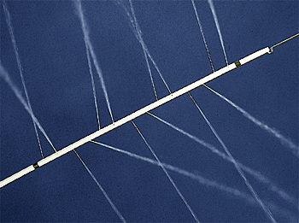
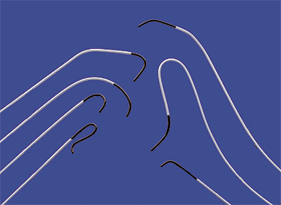
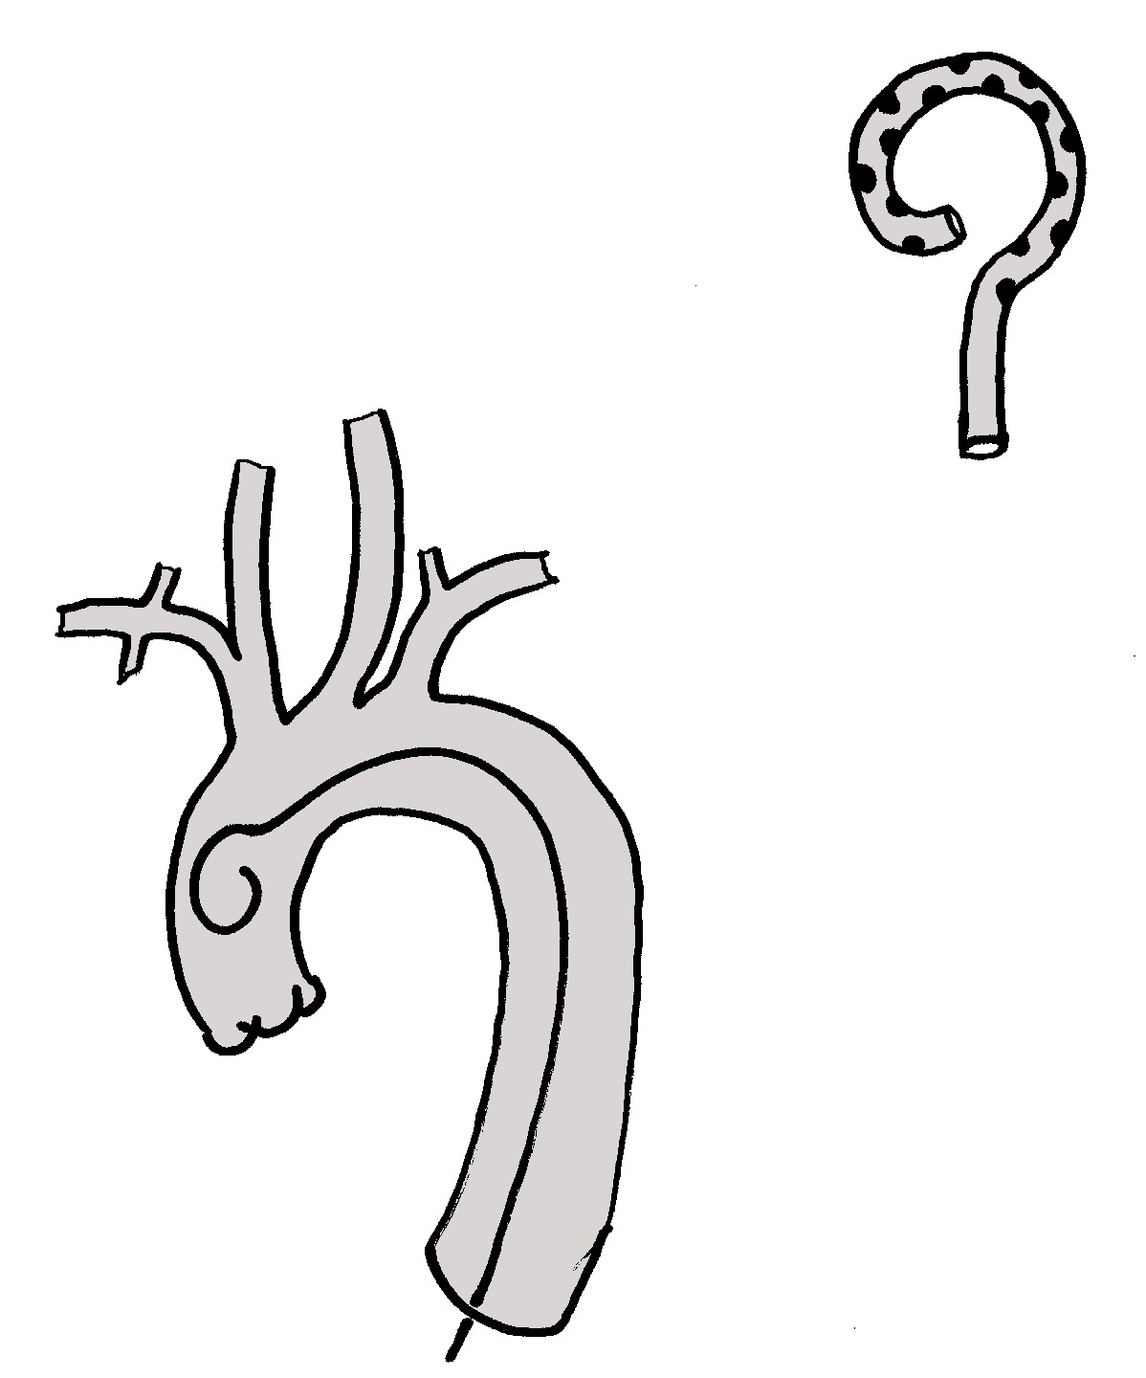
MATERIALS
Notes:
Catheters and hemostatic sheath, which allow us to gain access to the vessel without blood loss trough the puncture site

Slide 28
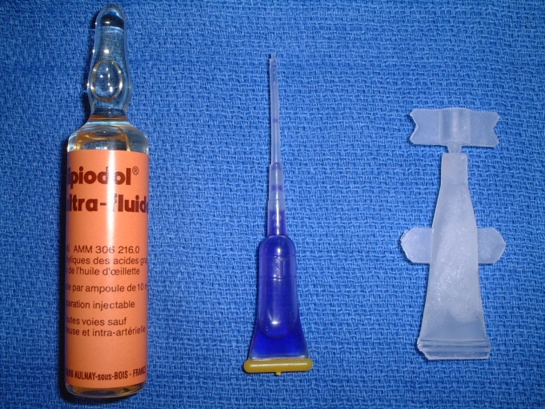
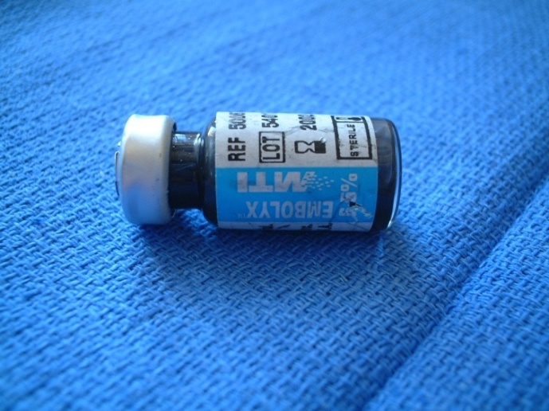
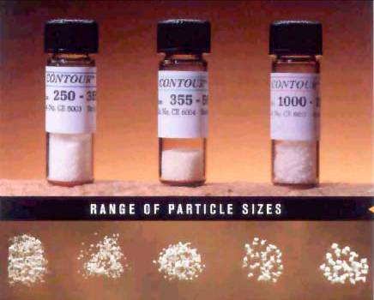
MATERIALS
Liquid Embolic Agents
Notes:
Catheters and hemostatic sheath, which allow us to gain access to the vessel without blood loss trough the puncture site

Slide 29
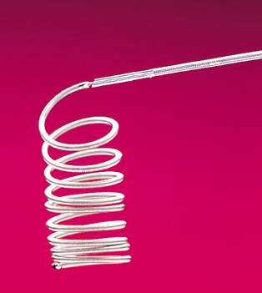
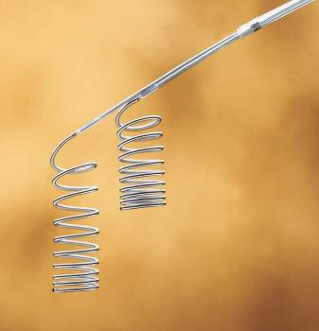
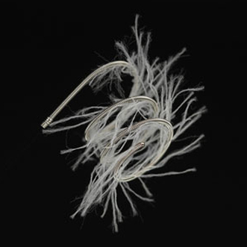
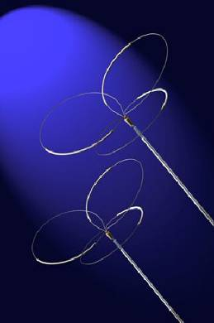
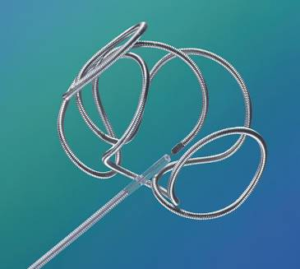
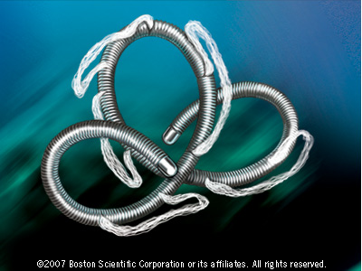
MATERIALS
Coils
Notes:
Catheters and hemostatic sheath, which allow us to gain access to the vessel without blood loss trough the puncture site

Slide 30
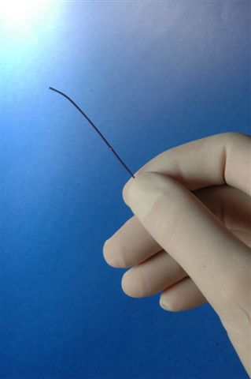
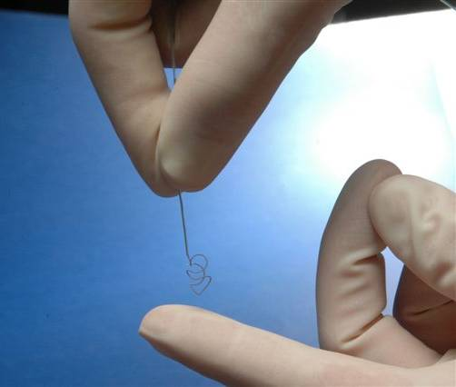
MATERIALS
Coils
Notes:
Catheters and hemostatic sheath, which allow us to gain access to the vessel without blood loss trough the puncture site

Slide 31
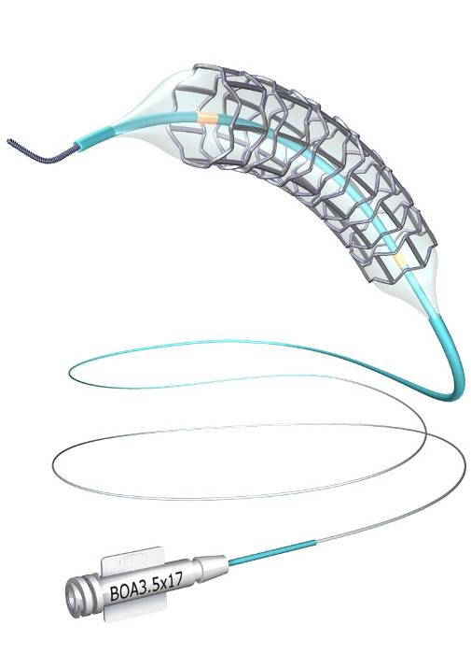
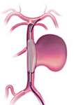
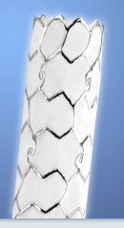
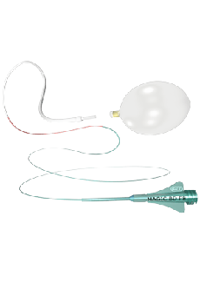
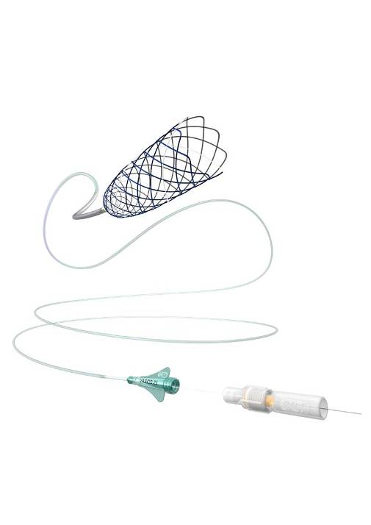
MATERIALS
Stents/Balloons
Notes:
Catheters and hemostatic sheath, which allow us to gain access to the vessel without blood loss trough the puncture site

Slide 32
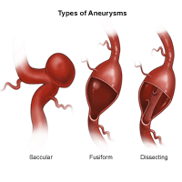

Brain Aneurysm
Notes:
A cerebral aneurysm (also called an intracranial aneurysm or brain aneurysm) is a bulging, weakened area in the wall of an artery in the brain, resulting in an abnormal widening or ballooning. Because there is a weakened spot in the artery wall, there is a risk for rupture of the aneurysm. Two other types of cerebral aneurysms are fusiform and dissecting aneurysms. A fusiform aneurysm bulges out on all sides (circumferentially). Fusiform aneurysms are generally associated with atherosclerosis.
A dissecting aneurysm may result from a tear in the inner layer of the artery wall, causing blood to leak into the layers. This may cause a ballooning out on one side of the artery wall or it may block off or obstruct blood flow through the artery.

Slide 33

Brain Aneurysm

Slide 34

Brain Aneurysm
Notes:
.

Slide 35

Brain Aneurysm
Notes:
A microcirurgia que consiste na realização de uma craniotomia e na clipagem do colo do aneurisma é um método conhecido por todos nós. Mas a mais de um século vários médicos tem tentado trata-los de forma menos invasiva.

Slide 36


Brain Aneurysm

Slide 37









Brain Aneurysm
Notes:
.

Slide 38


Brain Aneurysm

Slide 39


Brain Aneurysm

Slide 40

Brain Aneurysm

Slide 41


Brain Aneurysm

Slide 42

Brain Aneurysm

Slide 43

Brain Aneurysm

Slide 44

Brain Aneurysm

Slide 45

Brain Aneurysm

Slide 46


Brain Aneurysm

Slide 47


Brain Aneurysm

Slide 48


Brain Aneurysm

Slide 49
Brain Aneurysm

Slide 50

Arteriovenous Malformation (AVM)
Vascular malformation with arteriovenous shunts, that lack an intervening capillary bed
Notes:
Surgery;Radiosurgery;Embolization

Slide 51


Brain AVM

Slide 52

Brain AVM

Slide 53

Brain AVM

Slide 54


Brain AVM

Slide 55
Brain AVM

Slide 56



Carotid-cavernous fistula

Slide 57

Carotid-cavernous fistula

Slide 58




Carotid-cavernous fistula

Slide 59




Carotid-cavernous fistula

Slide 60

Carotid-cavernous fistula

Slide 61


Carotid-cavernous fistula

Slide 62

contrast-enhanced CT

Slide 63




Slide 64


Slide 65


Slide 66


Slide 67




Slide 68



Slide 69



Slide 71


Slide 72

Tumors

Slide 73




Tumors
Notes:
Tumores localmente agressivos que se originam de células da crista neural
50% - timpânicos ou jugulares
35% - tumores do corpo carotídeo
11% - vagais
6% outras localizações na cabeça e pescoço
10% - múltiplos Atividade secretória em 1%
Potencial maligno - <3%

Slide 74




Tumors

Slide 75





Tumors

Slide 76


Tumors

Slide 77


Tumors

Slide 78


Tumors

Slide 79

Tumors
Notes:
Radio-frequency ablation is one of the most promising thermal ablation techniques for the treatment of nonresectable hepatic tumors.
Recent studies have reported favorable survival rates and excellent rates of local control after such ablation, especially in patients with hepatocellular carcinoma. Basically, the term radio-frequency refers not to the emitted wave but rather to the alternating
electric current that oscillates in high frequency. Schematically, a closed-loop circuit is created by placing a generator, a large dispersive electrode (ground pad), a patient, and a needle electrode in series. This ionic agitation creates friction within the body and thus
Heat.

Slide 80



Tumors

Slide 81

Carotid Stenting
Avoid surgical trauma
Low rate of re-stenosis
3-5%
Low rate of complications
~3%

Slide 82

PROTECTION SYSTEMS

Slide 83


Slide 84



Carotid Stenting

Slide 85

Acute Stroke
Notes:
Restabelecimento precoce do fluxo sanguíneo
Evitar ou limitar a área de infarto cerebral
Evitar a progressão de morte celular na área de penumbra
Ampliar a janela terapêutica além de 3 horas (trombólise venosa)

Slide 86



Acute Stroke

Slide 87



Acute Stroke

Slide 88



Periphereal Stenosis

Slide 89


Non Vascular IR

Slide 90

Non Vascular IR

Slide 91


Tumors

Slide 92


Slide 93


Slide 94


Slide 95


Slide 96


Slide 97


Slide 98


Slide 99
Conclusions
Possibility of minimally invasive treatment of many diseases
Efficacy established
New materials
Improving technique
but...

Slide 100
Conclusions
Interventional radiology has been established as a medical specialty, which overlaps with many other medical fields, thus depending on interdisciplinary accordance between the interventional radiologist and surgeon/clinician aiming always to provide minimally invasive treatments with proven safety and efficacy for the patient.
Notes:
Active clinical involvement;
2. Strong relationships with hospital
administration;
3. Creative partnerships with
other disciplines, including revenue
sharing; and
4. Cooperation of noninterventional
Partners.

Slide 101

THANK YOU
Guilherme S. Nakiri
gsnakiri@yahoo.com.br

