Slide 1
Abdominoplasty in Perspective
Fabio Nahas, MD, MBA, PhD
Associate Professor, “Livre Docente”, Federal University of São Paulo - UNIFESP
National Secretary – International Society of Aesthetic Surgery - ISAPS

Slide 2
Venus of Willendorf
The most ancient representation of the human body
22.000 BC
André Gourhan, ethnologist

Slide 3
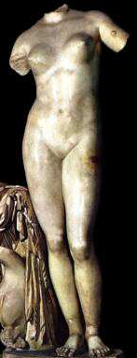
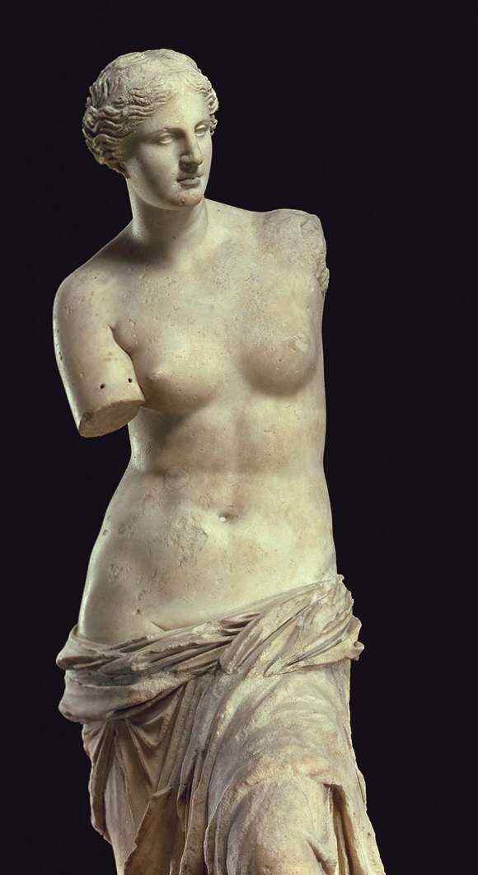
Venus
of Cirene, 315 BC
Renascentist
1490 AD
of Milo, 100 BC

Slide 4
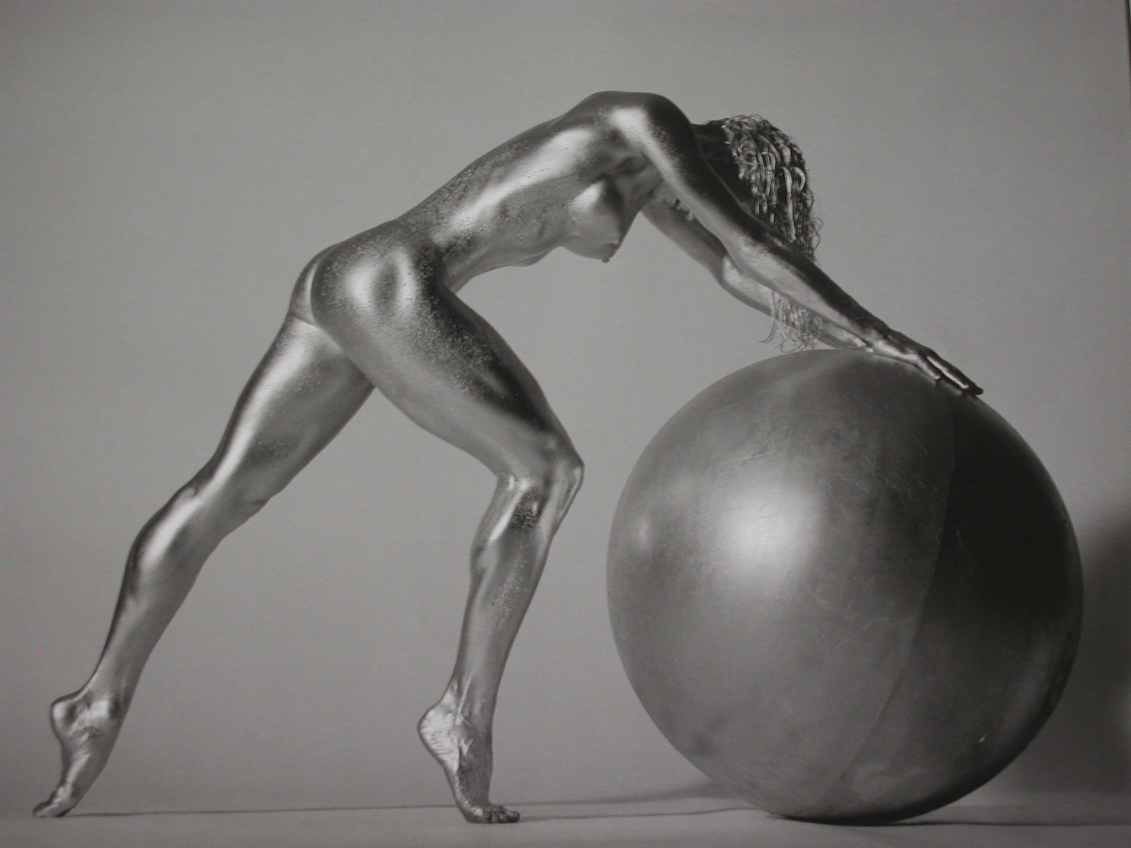
XXI Century

Slide 5
Plastic Surgery provides a way to improve self-esteem and self-image
Reconstructive
Aesthetic Surgery

Slide 6
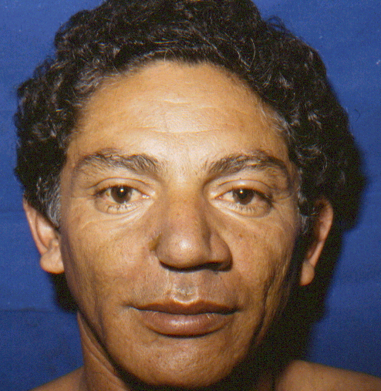
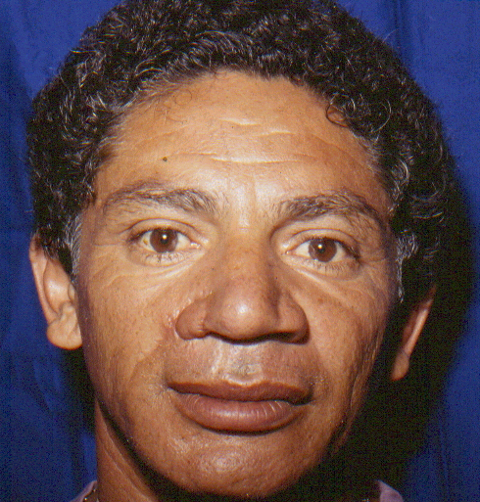
PRE
6-m PO
Local Flaps

Slide 7
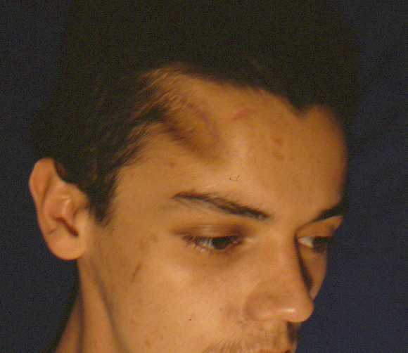
PRE
Craniofacial Surgery

Slide 8
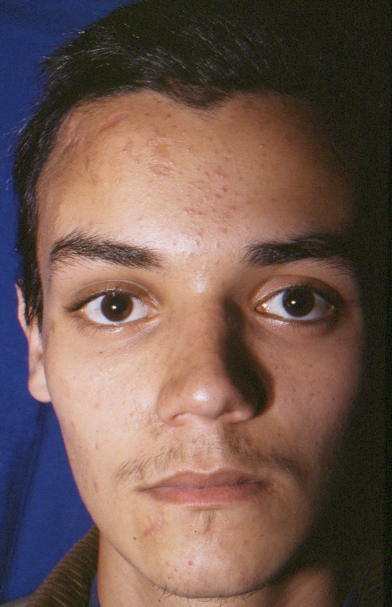
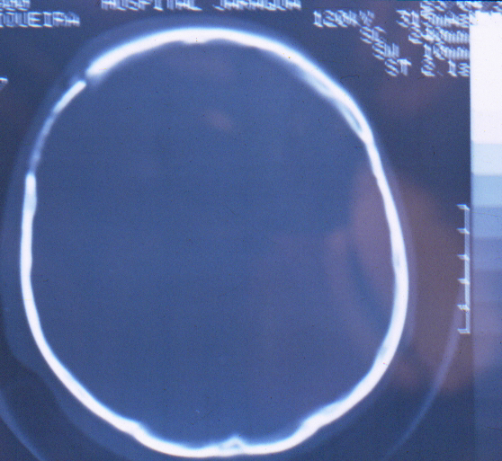
1-y PO

Slide 9
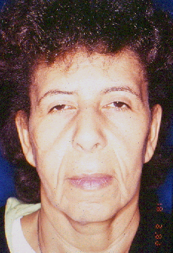
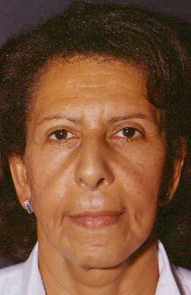
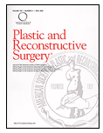
23 y-o
38 y-o
38 anos
Nahas FX, et al. The role of plastic surgery in congenital cutis laxa: a 10-year follow-up. Plast Reconstr Surg 1999; 104:1174-8.

Slide 10
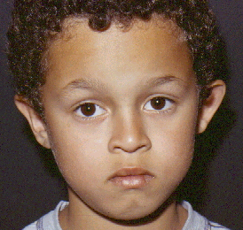
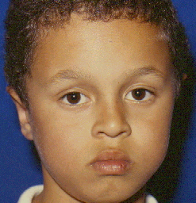
Aesthetic Surgery - Prominent Ears
PRE
6-m PO

Slide 11
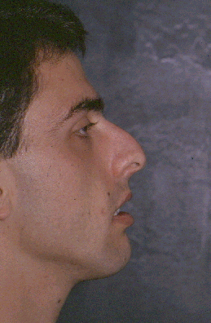
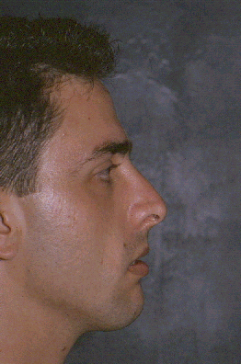
Rhynoplasty
PRE
8-m PO

Slide 12
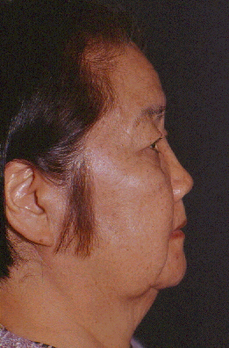
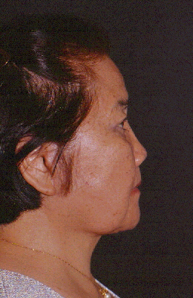
Face Lift
PRE
1-y PO

Slide 13
Breast Reduction
PRE
1-y PO

Slide 14
Liposuction
PRE
6m PO

Slide 15
Breast Augmentation
PRE
1-y PO

Slide 16
The development of Aesthetic and Reconstructive Surgery depends on research
The focus of this presentation will be on the correction of deformities of the musculoaponeurotic layer of the abdomen

Slide 17
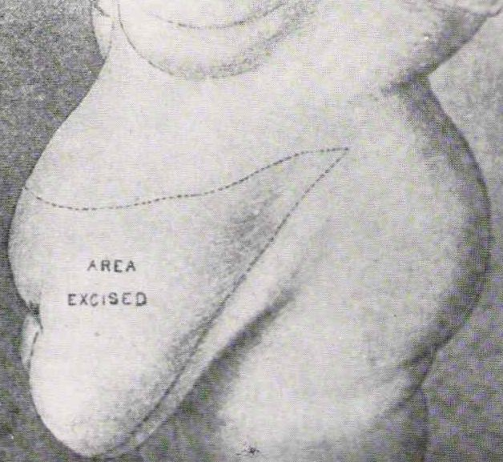
Since the primordium...
Reconstruction & Aesthetic
1890 - Demars; Marx – dermolipectomy and hernia correction
1911 - Desjardins – dermolipectomy with excision of a vertical ellipsis - (22.4 kg)

Slide 18
2. Deformities of the musculoaponeurotic layer
Correction of the separation of the rectus muscles (rectus diastasis)
Treatment of the laxity of the abdominal wall
Abdominal wall reconstruction

Slide 19
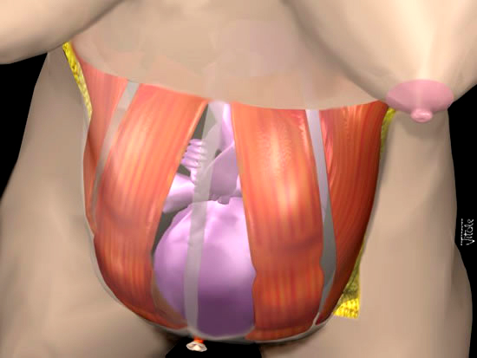
Rectus diastasis occurs during pregnancy

Slide 20
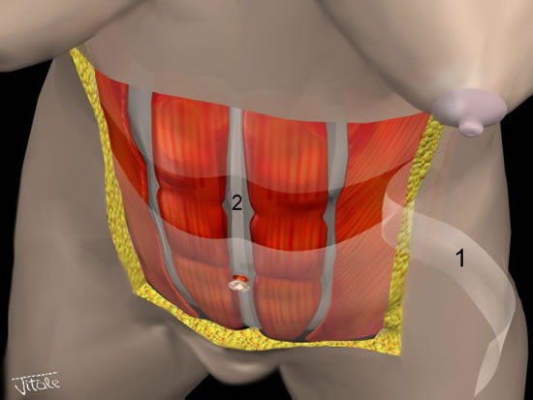
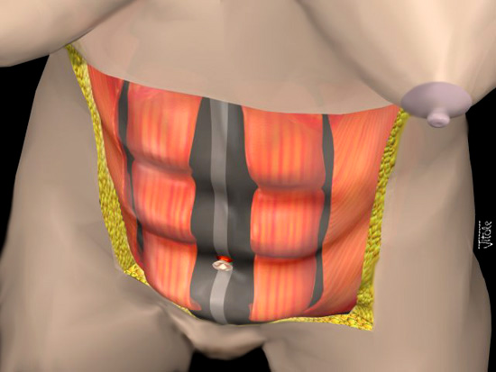
Rectus diastasis allows the organs to
project the abdominal wall anteriorly

Slide 21
It possible to correct rectus diastasis by laparoscopy
Limited Indications
1996

Slide 22
It is usually corrected by the plication of the anterior rectus sheath – The use of Nylon suture is effective
1997

Slide 23
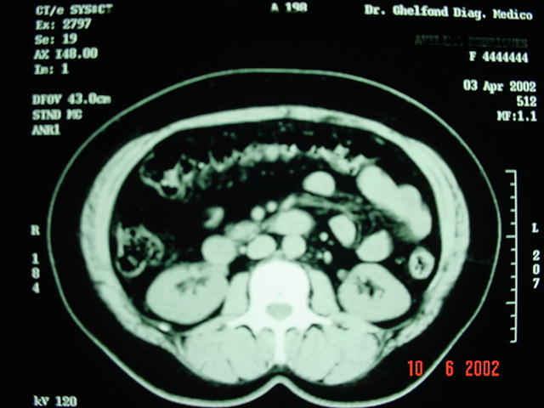
RD at the CT-scan
Pre
PO 6 m

Slide 24
PDS is effective in the correction of RD
2001

Slide 25
The plication is a longlasting procedure
2007

Slide 26
Preop
3 w PO
80 m PO

Slide 27
What will occur with the recti muscles if the patient gets pregnant?
2002

Slide 28
Pre
1-y PO

Slide 29
7-m pregnant
4 m after the delivery

Slide 30
4 months after the delivery
No diastasis
She was oriented to exercise

Slide 31
4 y after the delivery
Exercise is a very important issue after abdominoplasty

Slide 32
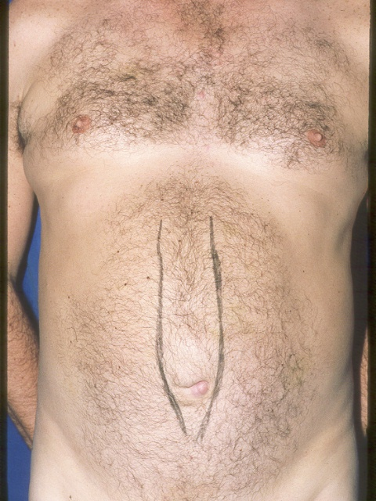
40 year-old male
RECURRENCE Lateral insertion of the recti muscles

Slide 33
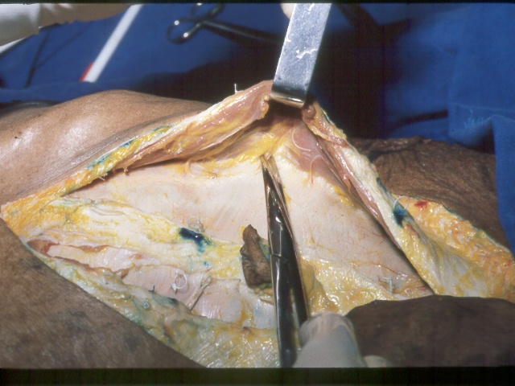
How can this type of deformity be treated?
Anatomical study: how to decrease tension of the fascia in these cases
Nahas FX. Resistência músculo-aponeurótica da parede abdominal à tração medial após secção e descolamento aponeurótico seletivos – estudo em cadáveres. Tese de Doutorado. Faculdade de Medicina da Universidade de São Paulo, 1997, p.95.

Slide 34
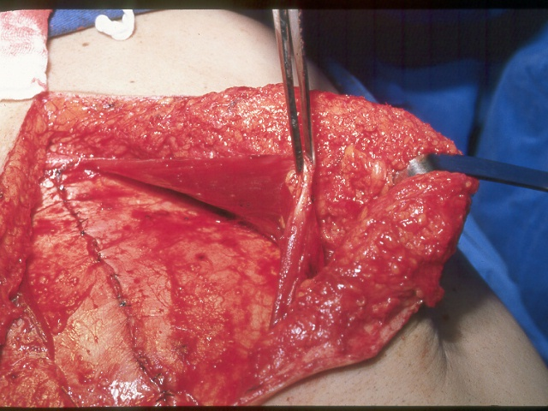
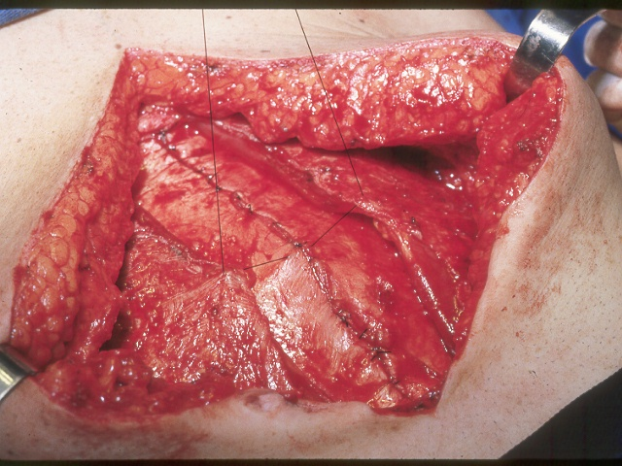
This technique was created based on the anatomical study

Slide 35
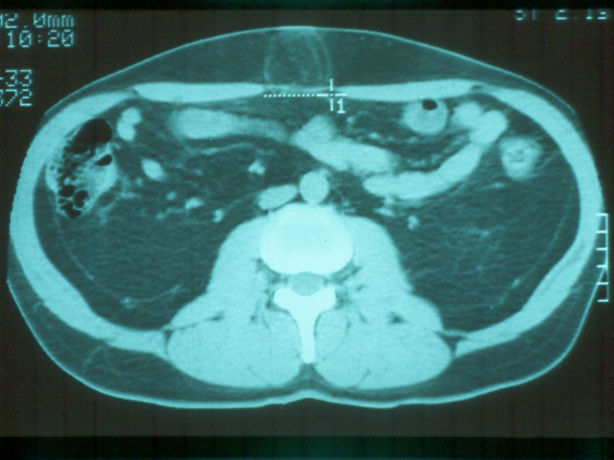
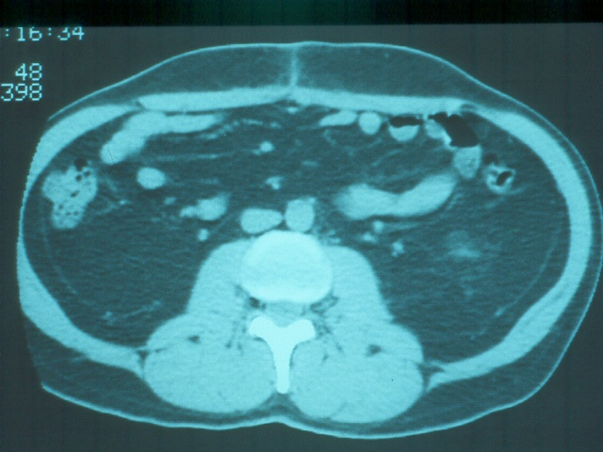
Pre
6 m PO
1998

Slide 36
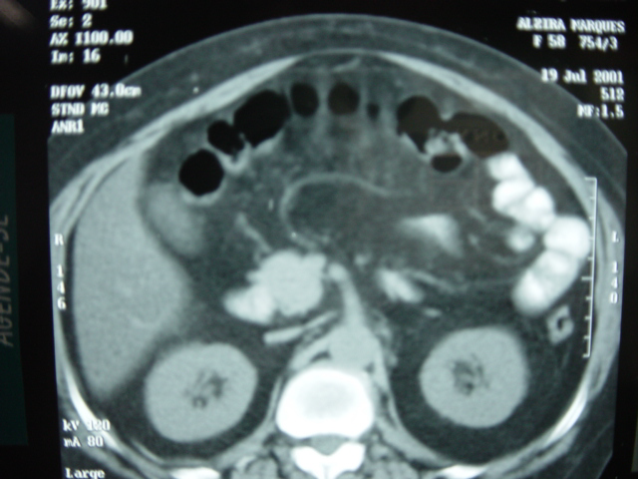
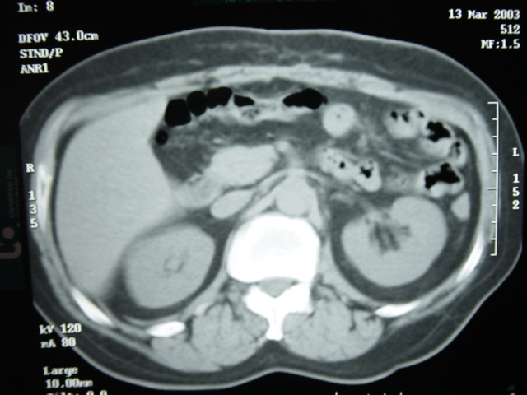
It is possible to correct recurrence of rectus diastasis using this technique
PRÉ
6mPO
Nahas FX, Ferreira LM, Mendes JA. An efficient way to correct recurrent rectus diastasis. Aesth Plast Surg. 2004; 28(4):189-96.

Slide 37
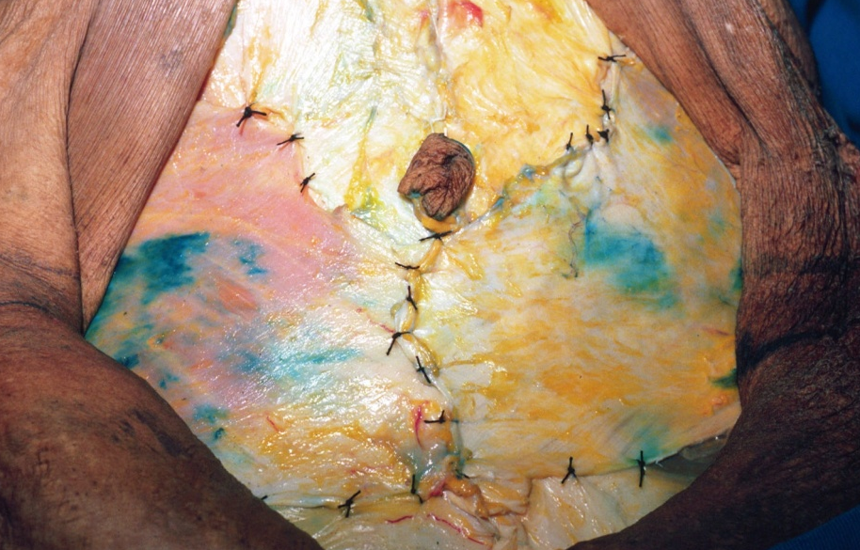
Improving the waistline and abdominal wall laxity
2001

Slide 38
Less elaborated techniques may solve a great part of the cases

Slide 39
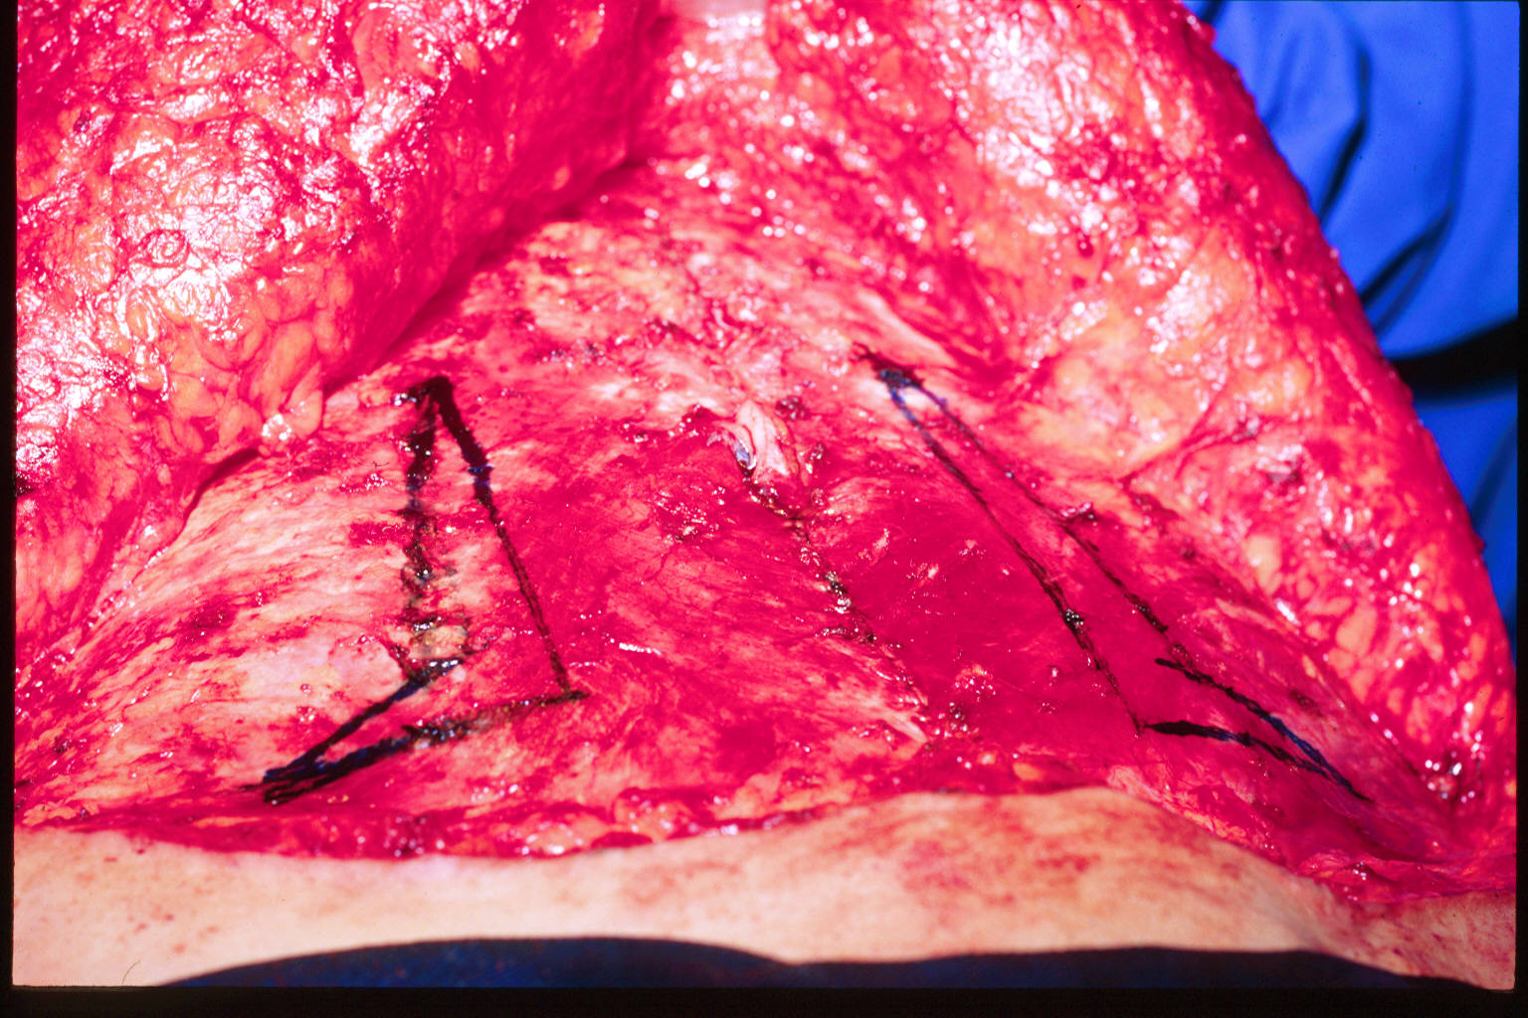
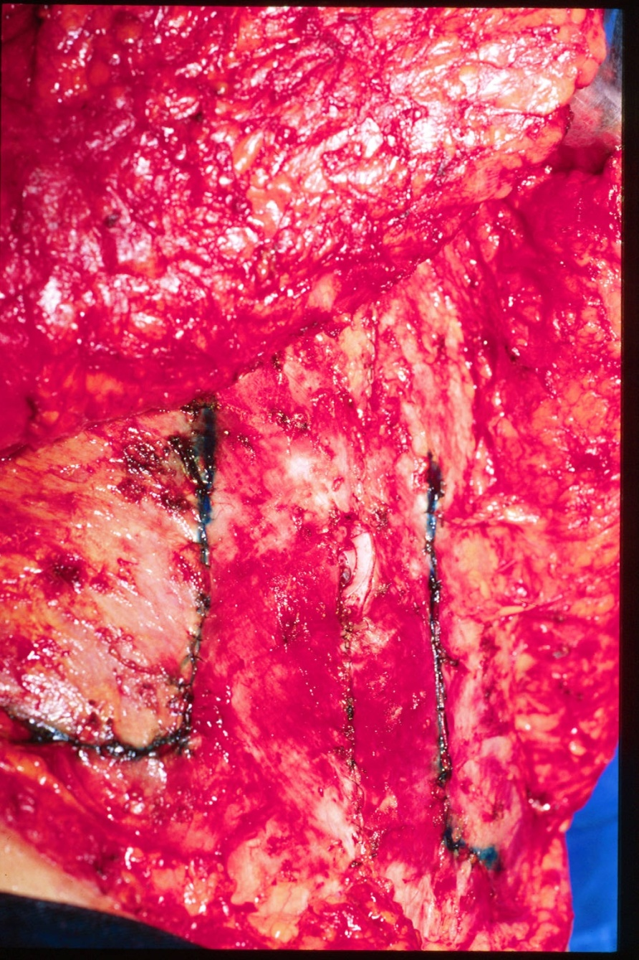
“L” Plication of the External Oblique Aponeurosis

Slide 40
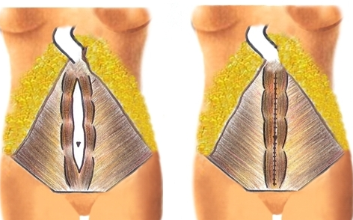
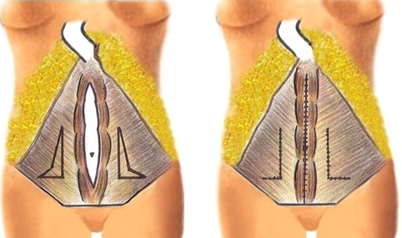
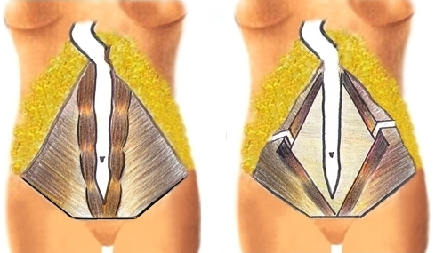
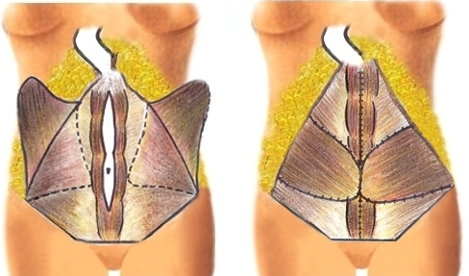
Classification and treatment of the musculo-aponeurotic deformities (n = 83)
A
B
C
D
Nahas FX. An aesthetic classification of the abdomen based on the myoaponeurotic layer. Plast. Reconstr. Surg. 2001; 108(6):1787-95.

Slide 41
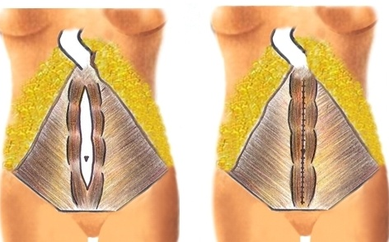
Type A
RD secondary to pregnancy
Plication of the anterior rectus sheath
Notes:
Pacientes com deformidade tipo A apresentam diástase de retos secundária à gestação e correspondem à grande maioria das pacientes de nossa casuística (57.6%). Nestes casos, apenas a plicatura da aponeurose anterior está indicada.

Slide 42
Type A: Plication of the anterior rectus sheath

Slide 43
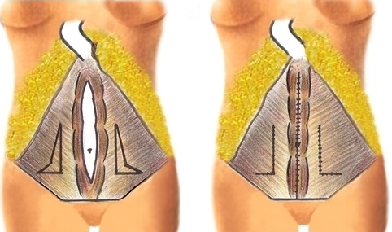
Type B
RD + lateral and infra-umbilical laxity of the myoaponeurotic layer
PARS + “L” Plication
Notes:
Pacientes tipo B apresentam, além da diástase de retos, flacidez lateral e infra-umbilical do plano mioaponeurótico. Corresponde a 9% das pacientes operadas. Deve-se, além de corrigir a diástase como no tipo A, realizar a plicatura da aponeurose dos músculos oblíquos externos em “L”.

Slide 44
“L” Plication
Notes:
Pacientes tipo B apresentam, além da diástase de retos, flacidez lateral e infra-umbilical do plano mioaponeurótico. Corresponde a 9% das pacientes operadas. Deve-se, além de corrigir a diástase como no tipo A, realizar a plicatura da aponeurose dos músculos oblíquos externos em “L”.

Slide 45
Type B
Effect on the abdominal contour

Slide 46
Type C
Congenital diastasis
Undermining and advancement of the recti muscles
Notes:
Pacientes tipo C apresentam inserção lateral congênita dos retos (6,3%). Estes casos devem ser tratados com avanço dos músculos retos e não através da simples plicatura aponeurótica. Este procedimento evita a recidiva pois, nestes casos, irá ocorrer o efeito de corda de violino, rompendo a sutura da plicatura com o passar do tempo, pela contração repetida dos retos.

Slide 47
Type C: Rectus M. advancement

Slide 48
Type D
RD + poorly defined waistline
PARS + External Oblique M. advancement
Notes:
Pacientes tipo D apresentam diástase de retos e cintura pouco definida. Representam 1,8% dos casos e o tratamento consiste em plicatura da aponeurose anterior associada ao avanço do músculo oblíquo externo.

Slide 49
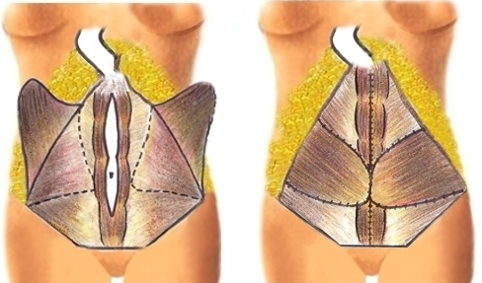
Type D: External oblique muscle advancement

Slide 50
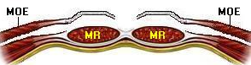
Abdominal wall reconstruction
The component’s separation principle
Tension Reduction of
the aponeurotic edges
Nahas FX et al. Abdominal Wall Closure After Selective Aponeurotic Incision and Undermining. Ann Plast Surg. 1998; 41(6): 606-17.
Barbosa MVJ, Nahas F X et al. Use of the anterior rectus sheath for abdominal wall reconstruction: A study in cadavers. Scand J Plast Reconstr Surg, v. 19, p. 1-5, 2007.
Barbosa MV, Nahas FX et al. A variation in the component separation technique That preserves the linea semilunaris: a study in cadavers and a clinical case. J Plast Reconstr Aesthet Surg. 2009. (Epub ahead of print)

Slide 51
“Components Separation” Technique

Slide 52
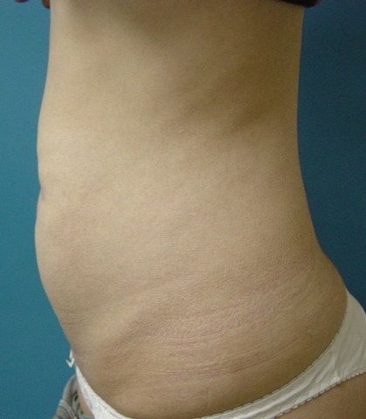
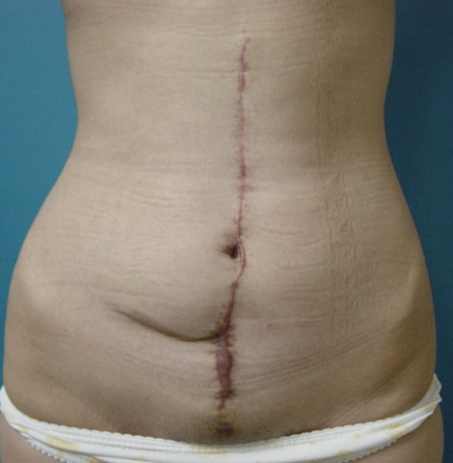
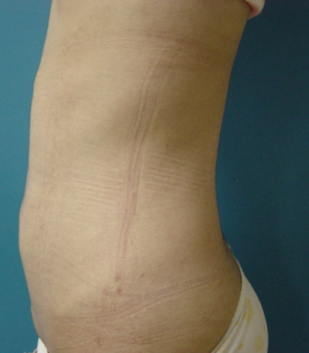
Abdominal wall reconstruction
Pre
1-y PO

Slide 53
Reconstructive and aesthetic procedures:
Promote a balance between the anterior and posterior abdominal wall

Slide 54
There is also an impact on the quality
of life after abdominoplasty
Self image and self-esteem
Experimental group: 24 patients
Control group: 15 patients
Rocha MJAB, Nahas FX. et al. Body shape questionnaire, Rosemberg/Unifesp Self-esteem Scale and the Short-Form 36 After Abdominoplasty. Ann Plast Surg. Accepted for publication.

Slide 55
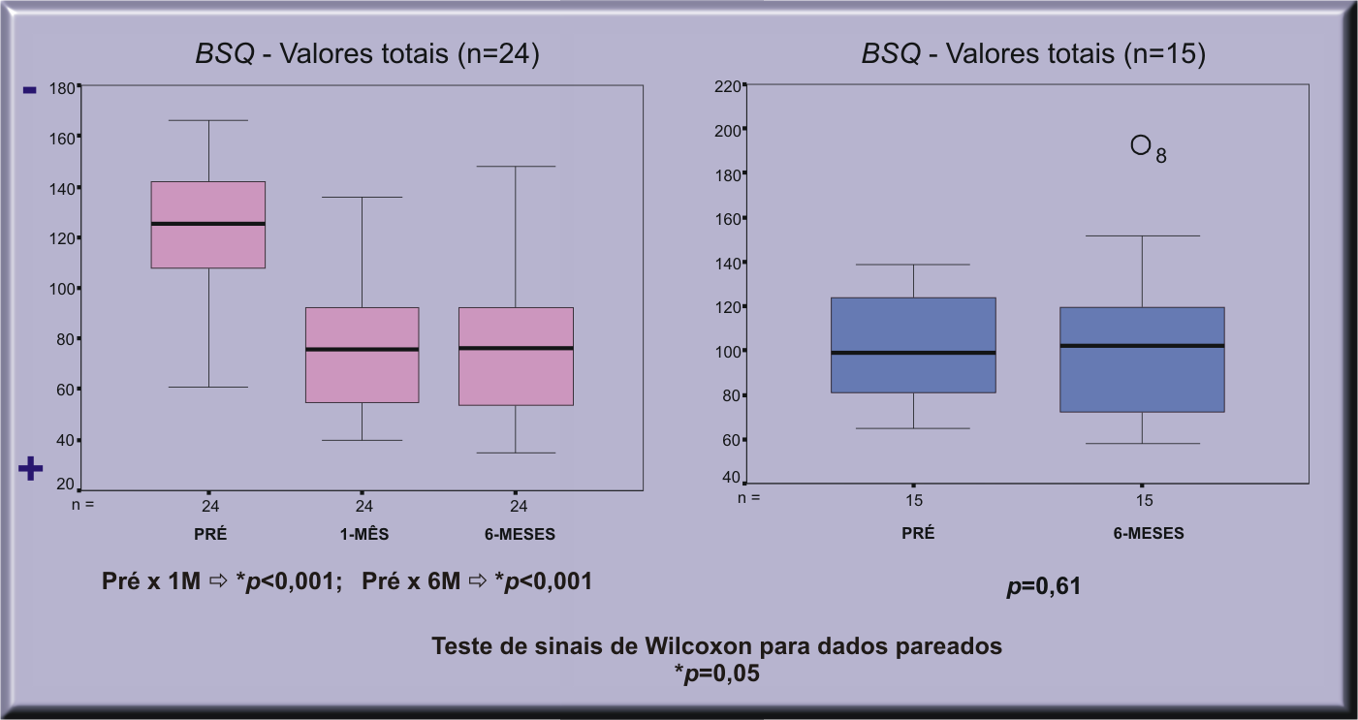
Body Shape Questionnaire – self image
Experimental Group Control Group

Slide 56
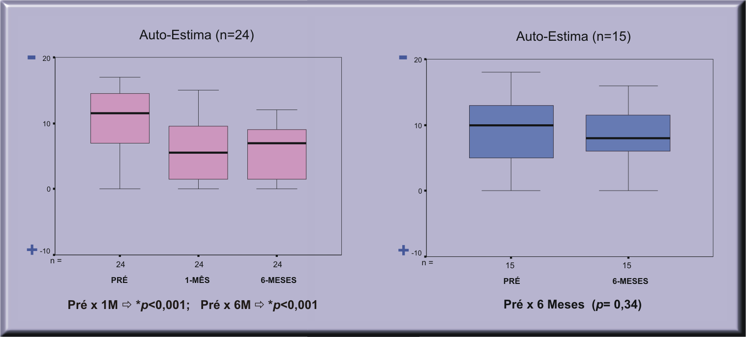
Rosemberg/Unifesp - Self-Esteem
Experimental Group Control Group

Slide 57
In conclusion:
Reconstructive and Aesthetic Surgery should always be associated in Plastic Surgery
Diagnosis of the deformity is paramount to get a good result

